Slide 1



Lecture 2:You do not have to get a job making games if you don’t want, it’s fine.
GAM340: Professional Practice
BA(Hons) Game Development

Slide 2
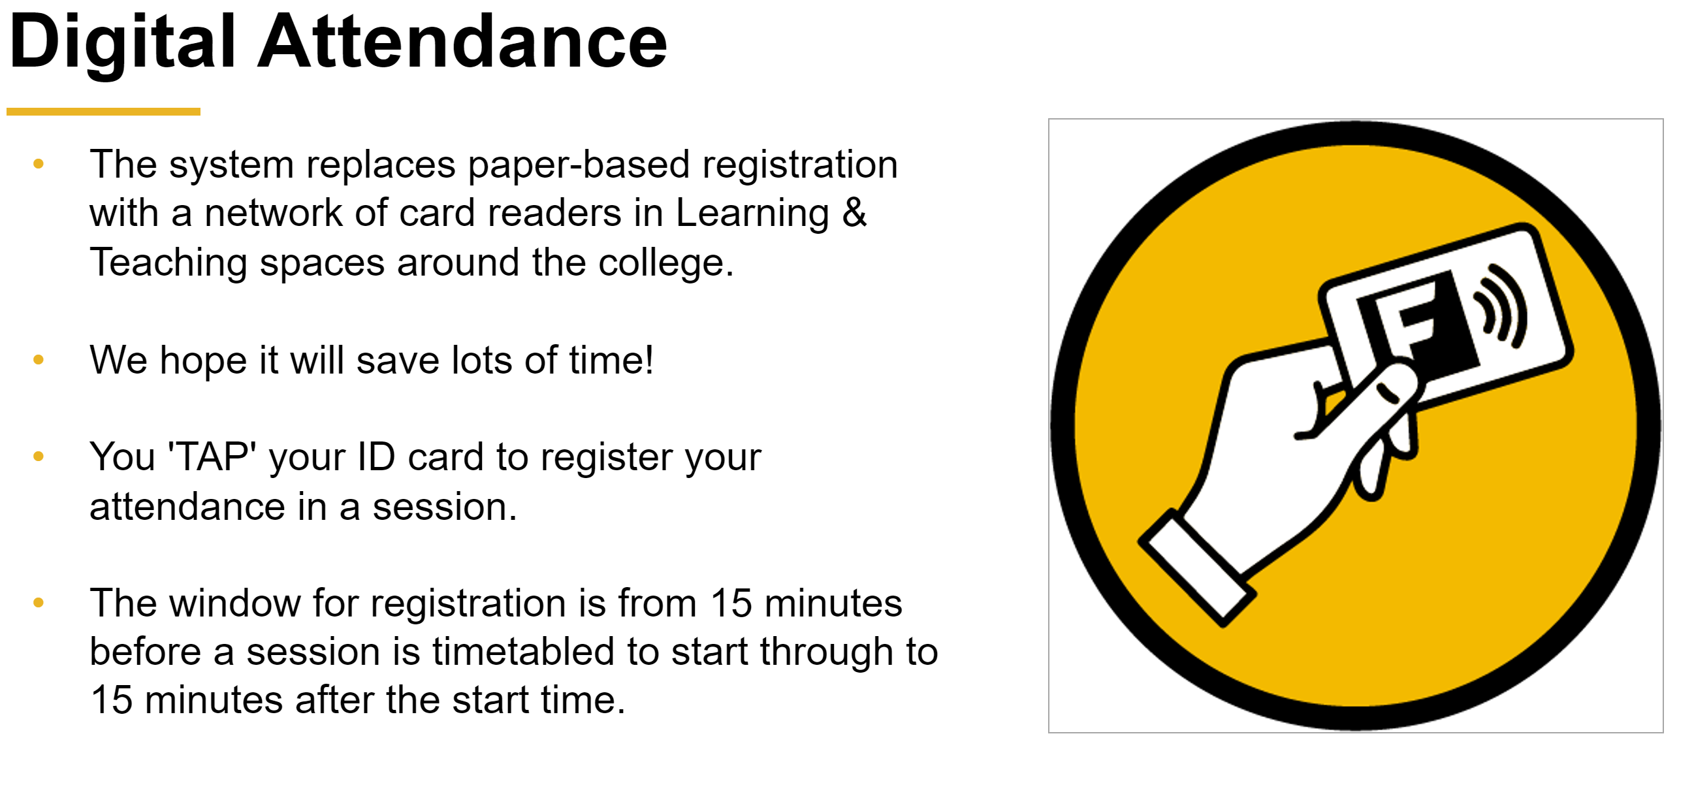

Slide 3
Learning Outcomes
Reflect on what you enjoy, what you are good at, what you feel you should do and where you may fit in society
Undertake appropriate psychological profiling questionnaires to better understand your needs and drives
Research the job market for roles that interest you and look for gaps between your current skillset and what is required for professional roles
Research suitable academic directions to take as a postgraduate

Slide 4
Introduction to the module
whoami?
Join linkedin and find out
https://www.linkedin.com/in/garethlewis/
Experienced Industry Professional
Lecturer at Falmouth
BA, BSc & MSc
Technology, Project Management & Business
Been in the IT / Games industry since 1994
Engineering Manager, Lionhead Studios
CTO of 4 start-ups
13 year as a technical consultant & business consultant in games and creative technology
Responsible for technical hiring at many games companies
Former Visiting Lecturer
MSc Games Development, Goldsmiths
BSc Games Development, Westminster
BSc Games Development, Plymouth
Game jam consultant, St. Martins, Malta.
4 Degrees
1992 BSc Computer Science
1993 MSc Intelligent Systems
2007 MBA
2016 BA Art History, History & Classics

Slide 5
What can old people teach us about anything?

Slide 6
Steve Jobs, Stanford Commencement Speech
Given in 2005
Probably the zenith of Jobs’ Apple adventure
In 1997, Jobs returned to a failing Apple
Re-focused company towards iMac and OSX to stabilise company finances
In 2001 Launched iPod & iTunes store, moved to Intel processors
2005 Apple had iPhone and iPad devices in R&D ready to launch in 2007 & 2010
Died in 2011 (56)

Slide 7

Steve Jobs, Stanford Commencement Speech
https://www.youtube.com/watch?v=UF8uR6Z6KLc

Slide 8
Steve Jobs, Stanford Commencement Speech
The takeaways:
1. Connect the dots
2. Love & Loss
3. Death

Slide 9
Steve Jobs, Stanford Commencement Speech
The takeaways:
1. Connect the dots
Do things you enjoy
Trust in yourself
Looking back, things will make sense
(It’s not about dropping out of your degree, unless it makes sense)
2. Love & Loss
3. Death

Slide 10
Steve Jobs, Stanford Commencement Speech
The takeaways:
1. Connect the dots
2. Love & Loss
Find what you love
Don’t settle
Work will fill a lot of your life, so fill it with things you love doing
3. Death

Slide 11
Steve Jobs, Stanford Commencement Speech
The takeaways:
1. Connect the dots
2. Love & Loss
3. Death
You have nothing to lose, so follow your heart
Your time is limited, don’t waste it living other’s lives

Slide 12
Steve Jobs, Stanford Commencement Speech
The takeaways:
So, everything is connected
Do things you find interesting and things should work out OK.
You get to define what OK is

Slide 13
It’s all about money, right?

Slide 14
It’s all about money, right?
As grads:
You’re carrying lots of debt
Money is a good way of showing success

Slide 15
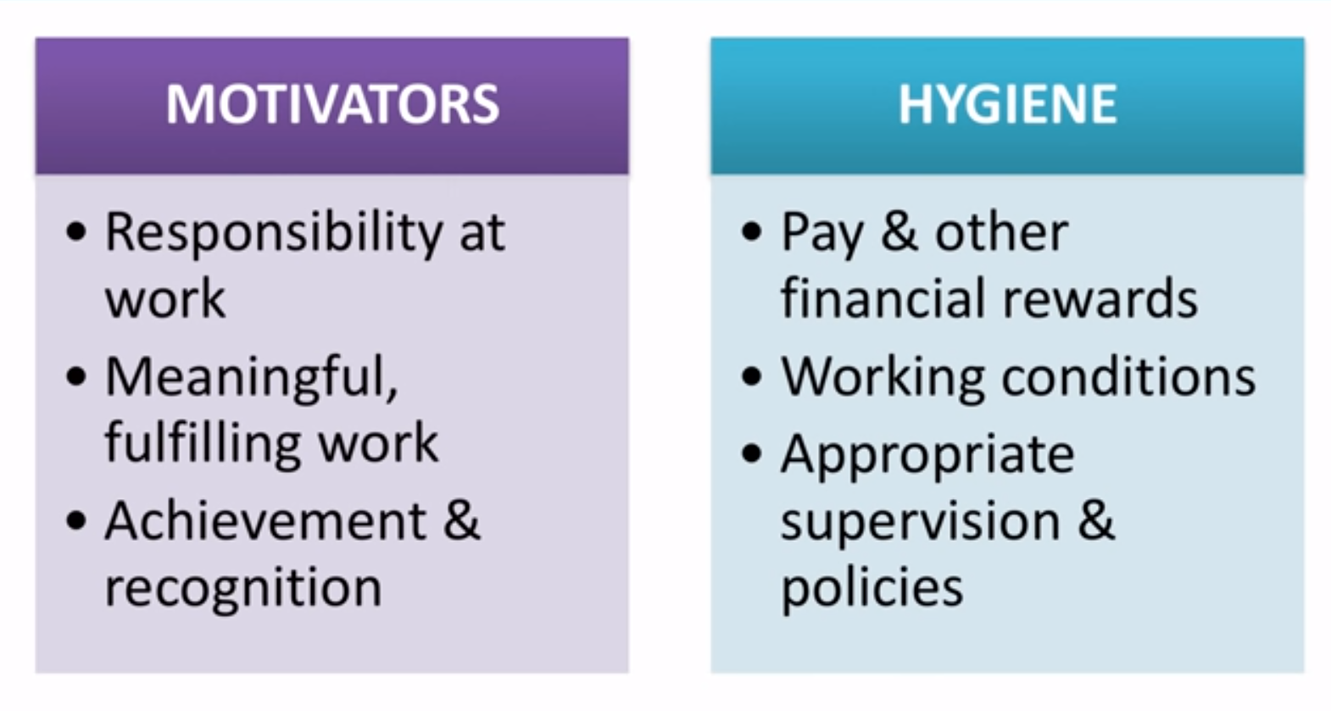
It’s all about money, right?
Herzberg 2 factor theory
Motivators are what make people get out of bed in the morning
Hygiene factors keep people at work (or push them away)

Slide 16
Ikigai (Ick-ee-guy)
Japanese concept of ‘sense of purpose’
Why millions of Japanese have a reason to get out of bed every morning
The intersection of:
What you are good at
What you can be paid for
What you love doing
What the world needs

Slide 17
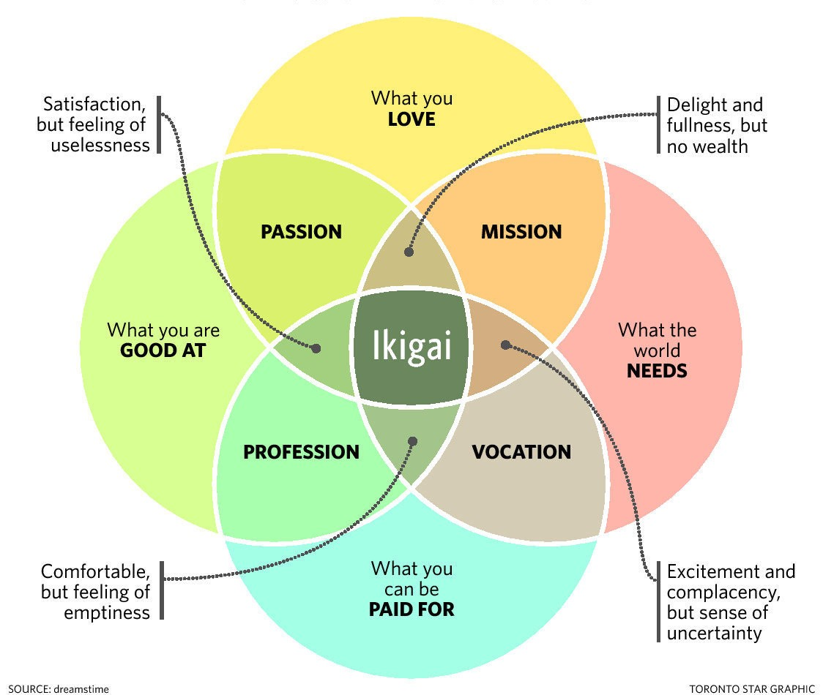
Ikigai

Slide 18
Ikigai
Ikigai shows two key outcomes:
1. The need for balance between the four areas
2. The symptoms where there is a lack of balance

Slide 19
Ikigai
Being a ‘struggling’ artist / creative / entrepreneur
‘empty’ achievements
Falling out of love with your career
Imposter syndrome

Slide 20
Jobs vs. Ikigai
Can see that Jobs’ philosophy is very personal
About defining what you want to do based on who you are and what floats your boat
Jobs may be swayed by being a multi-billionaire
Ikigai is very ‘Japanese’
About your role within a larger community, viz ‘what the world needs’ as part of your considerations
Also worth considering against the traditional ‘protestant work ethic’ taught in schools
Work hard and good things will come

Slide 21
Join LinkedIn and find lots of potted histories
https://www.linkedin.com/in/dimitrisgkoris/
https://www.linkedin.com/in/bmoiny/
https://www.linkedin.com/in/andrew-lindsay-6218711/
https://www.linkedin.com/in/sarah-m-panzu-94978155/

Slide 22
Where do you want to go?

Slide 23

Know thyself: Psychological profiling

Slide 24
Know thyself: Psychological profiling
One of the challenges with any ‘self-help’ is that often, authors will write from their own frame of reference (bias)
Knowing about yourself (what you like, dislike, how you like to work etc) will help you to make sense of things

Slide 25
Know thyself: Psychological profiling
MBTI (Myers-Brigs Type Indicator)
MBTI works on the principle that people have different drivers and this creates 16 different personality types
These types will generally operate in different ways
In terms of how they react to being with other people
How they process information
How they make decisions
How flexible they are to change

Slide 26
Know thyself: Psychological profiling
MBTI (Myers-Brigs Type Indicator)
These personality traits will give you some idea of how different types of people will react to you
Remember: ‘People like to work with people that they like, or at least can get on with professionally speaking’
And give you some idea as to why you operate the way you do

Slide 27
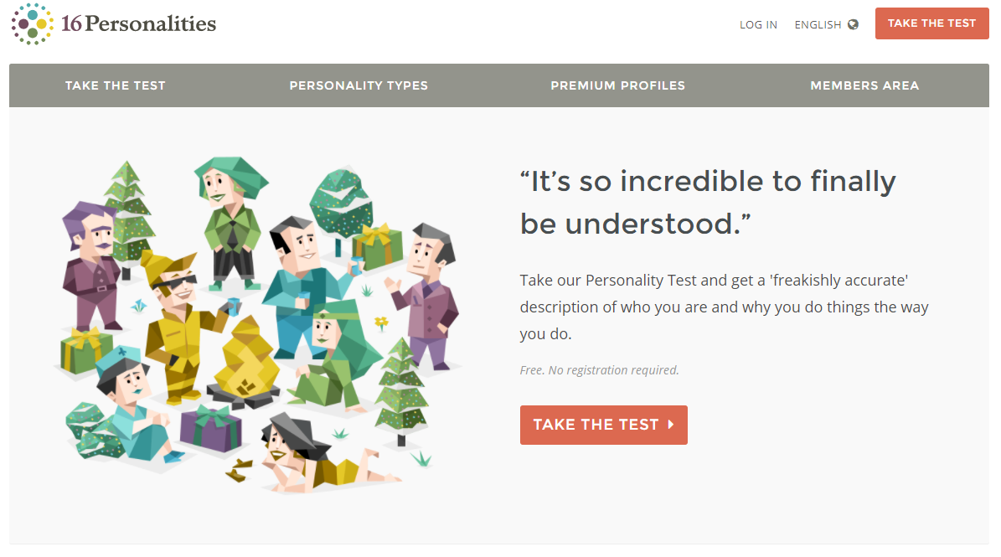
Know thyself: Psychological profiling
MBTI (Myers-Brigs Type Indicator)
If you haven’t done MBTI, here’s a good site
https://www.16personalities.com/

Slide 28
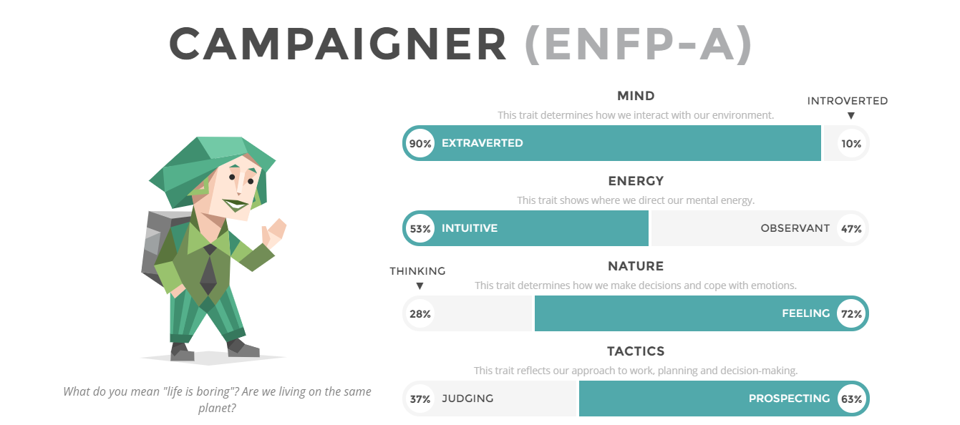
Know thyself: Psychological profiling
MBTI (Myers-Brigs Type Indicator)
Here’s mine
Some of the traits are quite extreme (ExFP), so I will normally come out as that
The S/N trait is 53:47, so this is easy to flip (ENFP to ESFP)
This makes it very easy to have ‘random’ MBTI if you sit in the middle of a few traits

Slide 29
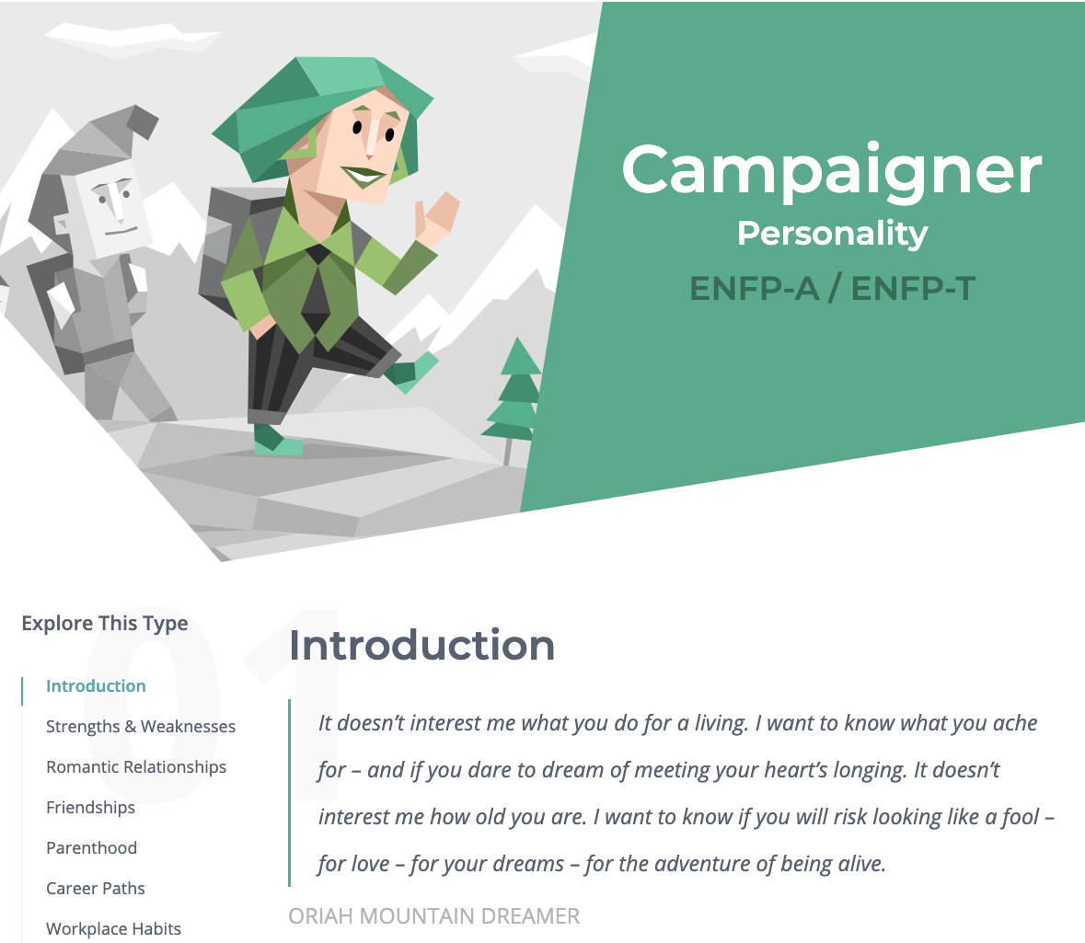
Know thyself: Psychological profiling
MBTI (Myers-Brigs Type Indicator)
Here’s mine
The ‘Explore this type’ section is where all the value is
Can provide some real insight
https://www.16personalities.com/enfp-personality

Slide 30
Know thyself: Psychological profiling
Belbin Team Roles
MBTI is not the only psychological profiling gig in town
Criticised for being fixed and like a ‘horoscope’
Belbin inventory is for your attraction to team roles
Comes from empirical team testing
Successful teams need a coordinator to manage group
Successful teams need no more than one shaper to drive the team (think Steve Jobs) multiple shapers will argue all the time
People can have attractions to multiple roles
Challenges are being aware of this and working out when to lean in / step back

Slide 31
Know thyself: Psychological profiling
Belbin Team Roles
123test.com/team-roles-test is a free Belbin inventory
Explorer
The explorer is generally an extrovert by nature. He or she is cheerful, gregarious. The explorer is also investigative, interested and curious about things. Because explorers like to improvise and communicate with others, they will have little problem presenting ideas to the team and developing new contacts.
Executive
The executive is sometimes also referred to as the organizer. The executive is generally disciplined and eager to get the job done. He or she is efficient, practical, and systematic. Executives are well organized and diligent, and quickly turn the ideas of a team into concrete actions and practical plans.
Expert
The expert has the skills and expertise required for the specific task at hand. He or she has a strong focus on the task and may get defensive when others interfere with his or her work. The expert prefers to work alone and team members often have a great deal of trust and confidence in him or her.

Slide 32
Know thyself: Psychological profiling
Belbin Team Roles
Annoyingly 123test uses its own names for Belbin roles
123Test | Belbin
Innovator | Plant
Explorer | Resource Investigator
Chairman | Co-ordinator
Executive | Implementer
Analyst | Monitor/Evaluator
Team Player | Team worker
Driver | Shaper
Completer | Completer/Finisher
Expert | Specialist
https://en.wikipedia.org/wiki/Team_Role_Inventories#Belbin_Team_Roles

Slide 33
Know thyself: Psychological profiling
Belbin Team Roles
https://www.accipio.com/eleadership/mod/wiki/view.php?id=1773

Slide 34
Know thyself: Psychological profiling
Benefit of psychological profiling is it helps you to understand yourself through external validation
Read the MBTI and Belbin descriptions to see what makes sense to you
Get feedback from your colleagues

Slide 35
Tea Break

Slide 36
Where do you want to go?

Slide 37
Where do you want to go?
Let’s make some broad criteria to cluster
Making content / not making content
‘content’ all assets (anim, art, audio, design, programming, writing)
Not content – managing / supervising what goes on
In the games industry / not in the games industry
Use your knowledge about the industry

Slide 38
Where do you want to go?
Jobs & Careers
In Industry / Not Asset Creation
Out of Industry / Not Asset Creation
Management / Production
PR, S&M, community mngt
Bizdev
Evangelism
Developer support
QA
Anything you fancy
In Industry / Asset Creation
Out of Industry / Asset Creation
Making games
Mashup job titles
Technical <role>
Creative <role>
Creating content about making games (writing, blogging, youtubing)
Making creative content
Webdev / web design / web content
Film/TV/Post
Appdev
Serious Games / Gamification
UX

Slide 39
Where do you want to go?
Where do the jobs live
In Industry / Not Asset Creation
&
In Industry / Asset Creation
Out of Industry / Not Asset Creation
Direct applications
Social media (industry groups, twitter)
www.linkedin.com
https://jobs.theguardian.com/
Direct applications
Social media (industry groups, twitter)
www.gamesindustry.biz/jobs
www.amiqus.com
www.opmjobs.com
www.gamesjobsdirect.com
www.linkedin.com
www.aswift.com
www.linkedin.com
Out of Industry / Asset Creation
Direct applications
Social media
www.linkedin.com
www.cwjobs.co.uk
www.softwarecornwall.org/jobs-2/
www.stackoverflow.com/jobs

Slide 40
Where do you want to go?
More education?
Approach universities directly for course information
Use industry social media to search out meaningful courses
Games-related
Not-games-related
Deeper education
M-Level
PhD
Deeper education
M-Level
PhD
Different Education
M-Level
PhD

Slide 41
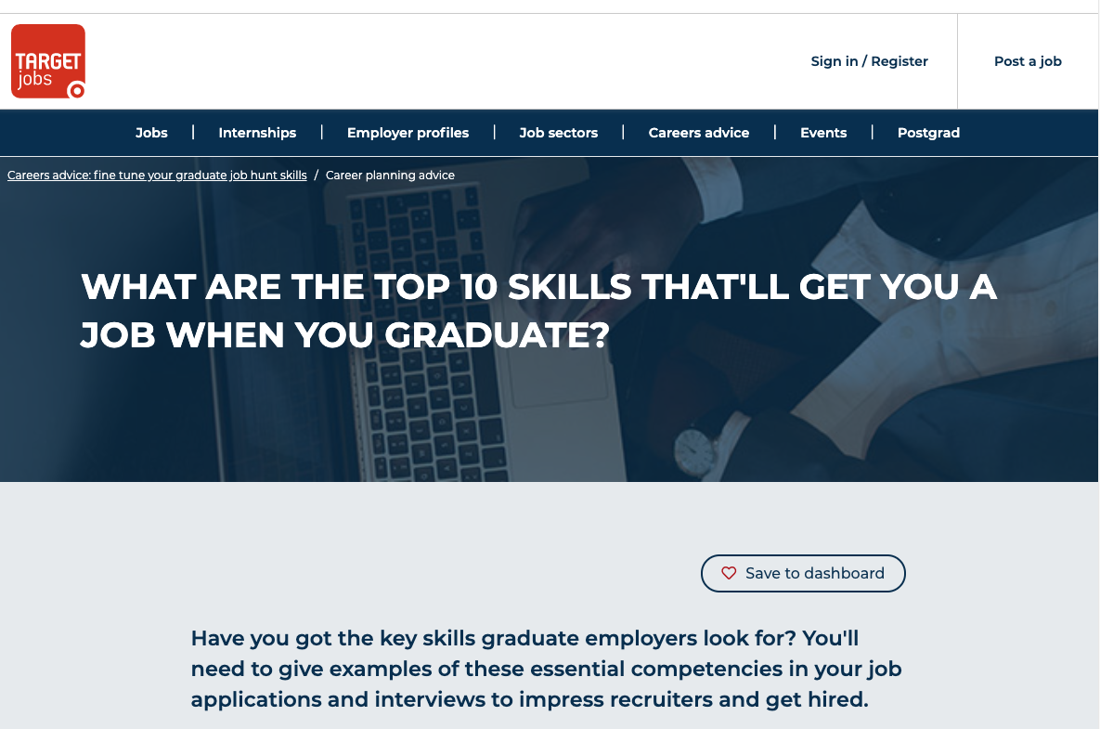
Where do you want to go?
I do or don’t want to go into games development
Vocational degrees are more than just the industry / route skills
https://targetjobs.co.uk/careers-advice/career-planning/273051-the-top-10-skills-thatll-get-you-a-job-when-you-graduate

Slide 42
Where do you want to go?
I do or don’t want to go into games development
Hopefully, your experiences in the Academy will demonstrate these skills
Key skills
Commercial awareness
Communication
Teamwork
Negotiation and persuasion
Problem solving
Leadership
Organisation
Perseverance and motivation
Ability to work under pressure
Confidence

Slide 43
Where do you want to go?
Key Skill | Hidden description of Key Skill (Education / projects)
Commercial Awareness | Put a game into an online store Did freelance work Did market analysis assignments / projects
Communication | Worked in a multi-disciplinary / cross-functional gamedev team
Negotiation and persuasion | Was scrum master Convinced the team to do X
Problem solving | Solved lots of problems in development projects / individual work
Leadership | Was lead <role> / scrum master
Organisation | Organised team work, organised own work
Perseverance and motivation | Solved hard problems, carried on attempting to solve problems when obvious solutions wouldn’t work Learnt & developed skills in <role> using MOOCs, other people, staff etc
Ability to work under pressure | Crunch, deadlines, multiple deadlines
Confidence | Did presentations Managed a team / Designed a game

Slide 44
Know yourself, plan yourself

Slide 45
Know yourself, plan yourself
Jobs, Ikigai and personal inventories are all fine and dandy
But, it’s nice to have models / approaches of developmental satisfaction that are more explicit in how to join the dots.

Slide 46
Know yourself, plan yourself
Jobs, Ikigai and personal inventories are all fine and dandy
But, it’s nice to have models / approaches of developmental satisfaction that are more explicit in how to join the dots.
Let’s think about three questions you can ask yourself
Where are you at?
Where do you want to be?
How are you going to get there?

Slide 47
Know yourself, plan yourself
Let’s think about three questions you can ask yourself
Where are you at?
Where do you want to be?
How are you going to get there?
We can use this as a developmental model of self-discovery
Where are you at?
Where do you want to be?
How are you going to get there?

Slide 48
Know yourself, plan yourself
Where are you at?
Where do you want to be?
How are you going to get there?
Your own internal monologue
What do you like / hate?
What really interests you?
What do you excel / struggle at
Course experiences
What does that say about what interests you?
What do your colleagues / staff think you excel at?
Your personality
Inventories

Slide 49
Know yourself, plan yourself
Where are you at?
Where do you want to be?
How are you going to get there?
What do you enjoy, what would you like to do more of?
What do you excel at, do you want to do more of it?
What do you find a struggle, do you want to get better at it?
What haven’t you done yet that you’d like to do?

Slide 50
Know yourself, plan yourself
Where are you at?
Where do you want to be?
How are you going to get there?
What can you do to develop your existing skills?
What can you do to create new skills?
What opportunities are available to showcase skills?

Slide 51
Know yourself, plan yourself
We can make this model a bit more interesting
Effectively,
This is ‘what do I want to do’ and ‘what skills do I need to develop’ to do it
Where are you at?
Where do you want to be?
How are you going to get there?

Slide 52
Know yourself, plan yourself
We can make this model a bit more interesting
Alternatively,
This is ‘what do I enjoy doing’ and ‘what doors does it open’
This is particularly useful when you want to think outside of your current ‘box’
I don’t want to be a games programmer, games designer, work in games etc
Where are you at?
What skills do I have?
What routes and careers does this open?

Slide 53
Wrap-up
Reflect on what you enjoy, what you are good at, what you feel you should do and where you may fit in society
Use Jobs talk & Ikigai to think about what motivates you
Use the 3-stage model from ‘Know yourself, plan yourself’ to explore

Slide 54
Wrap-up
Undertake appropriate psychological profiling questionnaires to better understand your needs and drives
You have MBTI and Belbin (123Test) to experiment with.
I look forward to hearing your results.
Remember, Belbin may give you some interesting insights for your group projects

Slide 55
Wrap-up
Research the job market for roles that interest you and look for gaps between your current skillset and what is required for professional roles
You have a list of recruitment services & types of roles that may interest you

Slide 56
Wrap-up
Research suitable academic directions to take as a postgraduate
Look at this as a route to career change or specialisation

Slide 57
Questions

